Slide 1
MIS 637
Data Analytics & Machine Learning
Clustering:
Hierarchical Clustering
k-Means Clustering
M. Daneshmand
MD-MIS 637 - Fall 2020

Slide 2
Clustering Task
  Clustering refers to grouping records, observations, or tasks into classes of similar objects
  Cluster is collection records similar to one another
  Records in one cluster dissimilar to records in other clusters
  Clustering is unsupervised data mining task
  Therefore, no target variable specified (no classification, estimation, prediction, etc.)
  Clustering algorithms segment records and maximize homogeneity in subgroups, similarity within the cluster is maximized
  Similarity to records outside the cluster minimized
MD-MIS 637 - Fall 2020

Slide 3
Clustering Task (cont’d)
  For example, Claritas, Inc. provides demographic profiles of geographic areas, according to zip code
  PRIZM segmentation system clusters zip codes in terms of lifestyle types
  Recall clusters identified for 90210 Beverly Hills, CA
  Cluster 01: Blue Blood Estates
    “Established executives, professionals, and ‘old money’ heirs that live in America’s wealthiest suburbs...”
  Cluster 10: Bohemian Mix
  Cluster 02: Winner’s Circle
  Cluster 07: Money and Brains
  Cluster 08: Young Literati
MD-MIS 637 - Fall 2020

Slide 4
What Tasks Can Data Mining Accomplish? (cont’d)
  Table shows 62 distinct “lifestyle” types used by PRIZM
01 Blue Blood Estates | 02 Winner's Circle | 03 Executive Suites | 04 Pools & Patios
05 Kids & Cul-de-Sacs | 06 Urban Gold Coast | 07 Money & Brains | 08 Young Literati
09 American Dreams | 10 Bohemian Mix | 11 Second City Elite | 12 Upward Bound
13 Gray Power | 14 Country Squires | 15 God's Country | 16 Big Fish, Small Pond
17 Greenbelt Families | 18 Young Influentials | 19 New Empty Nests | 20 Boomers & Babies
21 Suburban Sprawl | 22 Blue-Chip Blues | 23 Upstarts & Seniors | 24 New Beginnings
25 Mobility Blues | 26 Gray Collars | 27 Urban Achievers | 28 Big City Blend
29 Old Yankee Rows | 30 Mid-City Mix | 31 Latino America | 32 Middleburg Managers
33 Boomtown Singles | 34 Starter Families | 35 Sunset City Blues | 36 Towns & Gowns
37 New Homesteaders | 38 Middle America | 39 Red, White & Blues | 40 Military Quarters
41 Big Sky Families | 42 New Eco - topia | 43 River City, USA | 44 Shotguns & Pickups
45 Single City Blues | 46 Hispanic Mix | 47 Inner Cities | 48 Smalltown Downtown
49 Hometown Retired | 50 Family Scramble | 51 Southside City | 52 Golden Ponds
53 Rural Industria | 54 Norma Rae-Ville | 55 Mines & Mills | 56 Agri - Business
57 Grain Belt | 58 Blue Highways | 59 Rustic Elders | 60 Back Country Folks
61 Scrub Pine Flats | 62 Hard Scrabble
MD-MIS 637 - Fall 2020

Slide 5
What Tasks Can Data Mining Accomplish? (cont’d)
  What do the clusters mean?
  According to PRIZM, Clusters for Beverly Hills, CA 90210 include:
    Cluster 01: Blue Blood Estates
    Cluster 10: Bohemian Mix
    Cluster 02: Winner’s Circle
    Cluster 08: Young Literati
  Description of Cluster 01, “...’old money’ heirs that live in America’s wealthiest suburbs...accustomed to privilege and live luxuriously...”
MD-MIS 637 - Fall 2020

Slide 6
Clustering Task (cont’d)
Clustering Tasks in Business and Research
  Target marketing for niche product, without large marketing budget
  Segment financial behavior into benign and suspicious categories
  Gene expression clustering, where genes exhibit similar characteristics
  As a dimension-reduction tool when data has hundreds of attributes
  Clustering often performed as preliminary step in data mining process
  Clustering results used as input to other data mining techniques
MD-MIS 637 - Fall 2020

Slide 7
Clustering Task (cont’d)
  Applying cluster analysis to enormous databases helpful
  Reduces search space for downstream algorithms
Cluster analysis addresses similar issues encountered in classification
  Measuring Similarity
  Recoding categorical variables
  Standardizing and normalizing variables
  Number of clusters
MD-MIS 637 - Fall 2020

Slide 8
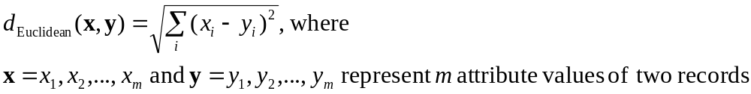
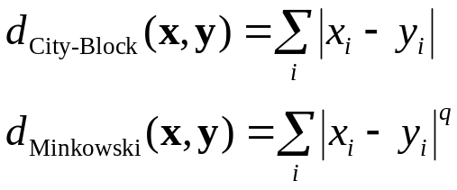
Clustering Task (cont’d)
Measuring Similarity
  Euclidean Distance measures distance between records
  Other distance measurements include City-Block Distance and Minkowski Distance
MD-MIS 637 - Fall 2020

Slide 9
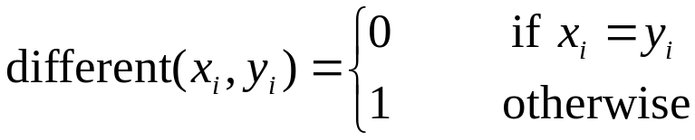
Clustering Task (cont’d)
  “Different From” function measures similarity between categorical attributes
  Substitute different(x,y) for each categorical attribute in Euclidean Distance function
  Normalizing data enhances performance of clustering algorithms
  Use Min-max Normalization or Z-Score Standardization
MD-MIS 637 - Fall 2020

Slide 10
Clustering Task (cont’d)
  Clustering identifies groups of highly-similar records
  Algorithms construct clusters where between-cluster variation (BCV) large, as compared to within-cluster variation (WCV)
  Analogous to concept behind analysis of variance
Between-cluster variation:
Within-cluster variation:
MD-MIS 637 - Fall 2020

Slide 11
Hierarchical Clustering Methods
  Clustering algorithms either Hierarchical or Non-Hierarchical
Hierarchical
  Tree like cluster structure (dendogram) created through recursive partitioning (Divisive Methods) or combining (Agglomerative Methods) of existing clusters
  Divisive Methods
  All records initialized into single cluster
  At each iteration, most dissimilar record split off into separate cluster
  Continues until each record represents single cluster
MD-MIS 637 - Fall 2020

Slide 12
Hierarchical Clustering Methods (cont’d)
  Agglomerative/Combining Methods
  Each observation initialized to become its own cluster
  At each iteration two closest clusters aggregated together
  Number of clusters reduced by one, each step
  Eventually, all records combined into single cluster
  Agglomerative/Combining more popular hierarchical method
  Therefore, focus remains on this approach
  Measuring distance between records/points straightforward once recoding and normalization applied
  However, how is distance between clusters determined?
MD-MIS 637 - Fall 2020

Slide 13
Hierarchical Clustering Methods (cont’d)
Distance Between Clusters
  Several criteria examined to determine distance between clusters, A and B
  Single Linkage
  Known as Nearest-Neighbor Approach
  Minimum distance between any record in cluster A, and any record in cluster B
  Cluster similarity based on most similar records from each cluster
  Tends to form long, slender clusters
  Sometime heterogeneous records clustered together
MD-MIS 637 - Fall 2020

Slide 14
Hierarchical Clustering Methods (cont’d)
  Average Linkage
  In average linkage, the criterion is the average distance of all records in cluster A, from all records in cluster B
  Resulting clusters have approximately equal within-cluster variability
  Complete Linkage: farthest-neighbor approach, maximum distance between any records in cluster A and any record in cluster B
  Example: Single-Linkage
  Single - linkage method examined using small data set:
  2 5 9 15 16 18 25 33 33 45
MD-MIS 637 - Fall 2020

Slide 15
Single-Linkage Clustering
  To begin, each record assigned to its own cluster
  Single-linkage seeks minimum distance between any two records, in separate clusters
  Step 1: Minimum cluster distance is between clusters {33} and {33}. Distance = 0, clusters combined
  Step 2: Clusters {15} and {16} combined, where distance = 1
  Step 3: Cluster {15, 16} combined with cluster {18}, distance between 16 and 18 is two, the minimum among clusters
  Step 4: Clusters {2} and {5} combined
2 | 5 | 9 | 15 | 16 | 18 | 25 | 33 | 33 | 45
2, 5
15, 16
33, 33
15, 16, 18
MD-MIS 637 - Fall 2020

Slide 16
Single-Linkage Clustering (cont’d)
2 | 5 | 9 | 15 | 16 | 18 | 25 | 33 | 33 | 45
  Agglomeration/Combining continues similarly Steps 4 – 9
  Above, last cluster {2, 5, 9, 15, 16, 18, 25, 33, 33, 45} contains all records in data set
2, 5
15, 16
33, 33
2, 5, 9
15, 16, 18
2, 5, 9, 15, 16, 18
2, 5, 9, 15, 16, 18, 25
2, 5, 9, 15, 16, 18, 25, 33, 33
2, 5, 9, 15, 16, 18, 25, 33, 33, 45
MD-MIS 637 - Fall 2020

Slide 17
k-Means Clustering
  k-Means effective at finding clusters in data
k-Means Algorithm
  Step 1: Analyst specifies k = number of clusters to partition data
  Step 2: k records randomly assigned to initial clusters and
  serve as initial cluster center
  Step 3: For each record, find the nearest cluster center,
  Each cluster center “owns” subset of records, we have
  a partition of data set into k clusters, C1, C2, ...., Ck
  Step 4: For each of k clusters, find cluster centroid
  Update cluster center location to centroid
  Step 5: Repeats Steps 3 – 5 until convergence or termination
MD-MIS 637 - Fall 2020

Slide 18
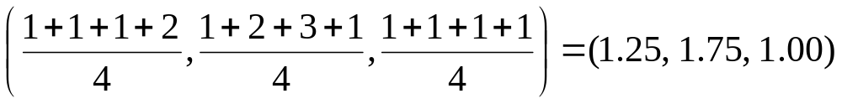
k-Means Clustering (cont’d)
  Nearest criterion in Step 3 typically Euclidean Distance
Determining Cluster Centroid
  Assume n data points (a1, b1, c1), (a2, b2, c2), ..., (an, bn, cn)
  Centroid of points is center of gravity of points
  Located at point (Σ ai/n, Σ bi/n, Σ ci/n)
  For example, points (1, 1, 1), (1, 2, 1), (1, 3, 1), and (2, 1, 1) have centroid
MD-MIS 637 - Fall 2020

Slide 19
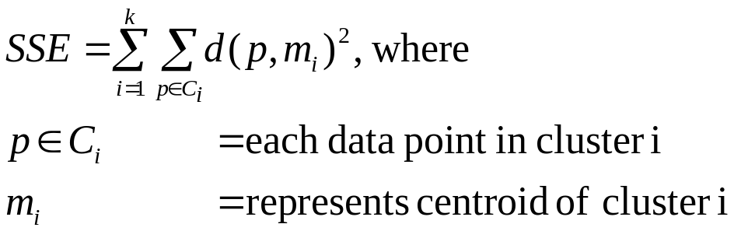
k-Means Clustering (cont’d)
  k-Means algorithm terminates when centroids no longer change
  For k clusters, C1, C2, ...., Ck, all records “owned” by cluster remain in cluster
  Convergence criterion may also cause termination
  For example, no significant reduction in SSE
MD-MIS 637 - Fall 2020

Slide 20
Example of k-Means Clustering at Work
  Assume k = 2 to cluster following data points
  Step 1: k = 2 specifies number of clusters to partition
  Step 2: Randomly assign k = 2 cluster centers
  For example, m1 = (1, 1) and m2 = (2, 1)
First Iteration
  Step 3: For each record, find nearest cluster center
  Euclidean distance from points to m1 and m2 shown
a | b | c | d | e | f | g | h
(1, 3) | (3, 3) | (4, 3) | (5, 3) | (1, 2) | (4, 2) | (1, 1) | (2, 1)
Point | a | b | c | d | e | f | g | h
Distance from m₁ | 2.00 | 2.83 | 3.61 | 4.47 | 1.00 | 3.16 | 0.00 | 1.00
Distance from m₂ | 2.24 | 2.24 | 2.83 | 3.61 | 1.41 | 2.24 | 1.00 | 0.00
Cluster Membership | C₁ | C₂ | C₂ | C₂ | C₁ | C₂ | C₁ | C₂
MD-MIS 637 - Fall 2020

Slide 21
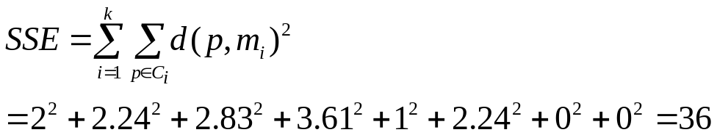
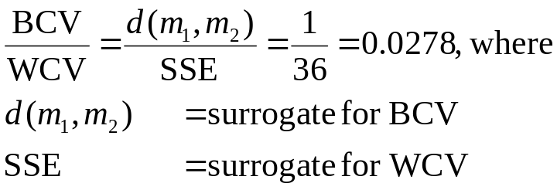
Example of k-Means Clustering at Work (cont’d)
  Cluster m1 contains {a, e, g} and m2 has {b, c, d, f, h}
  Cluster membership assigned, now SSE calculated
  Recall clusters constructed where between-cluster variation (BCV) large, as compared to within-cluster variation (WCV)
  Ratio BCV/WCV expected to increase for successive iterations
MD-MIS 637 - Fall 2020

Slide 22
Example of k-Means Clustering at Work (cont’d)
  Step 4: For k clusters, find cluster centroid, update location
  Cluster 1 = [(1 + 1 + 1)/3, (3 + 2 + 1)/3] = (1, 2), Cluster 2 = [(3 + 4 + 5 + 4 + 2)/5, (3 + 3 + 3 + 2 + 1)/5] = (3.6, 2.4)
  Figure shows movement of clusters m1 and m2 (triangles) after first iteration of algorithm
5
4
3
2
1
0
0 1 2 3 4 5 6
MD-MIS 637 - Fall 2020

Slide 23
Example of k-Means Clustering at Work (cont’d)
  Step 5: Repeats Steps 3 – 4 until convergence or termination
Second Iteration
  Repeat procedure for Steps 3 – 4
  Again, for each record find nearest cluster center m1 = (1, 2) or m2 = (3.6, 2.4)
  Cluster m1 contains {a, e, g, h} and m2 has {b, c, d, f}
  SSE = 7.86, and BCV/WCV = 0.3346
  Note 0.3346 has increased compared to First Iteration value = 0.0278
  Between-cluster variation increasing with respect to Within-cluster variation
MD-MIS 637 - Fall 2020

Slide 24
Example of k-Means Clustering at Work (cont’d)
  Cluster centroids updated to m1 = (1.25, 1.75) or m2 = (4, 2.75)
  After Second Iteration, cluster centroids shown to move slightly
5
4
3
2
1
0
0 1 2 3 4 5 6
MD-MIS 637 - Fall 2020

Slide 25
Example of k-Means Clustering at Work (cont’d)
Third (Final) Iteration
  Repeat procedure for Steps 3 – 4
  Now, for each record find nearest cluster center m1 = (1.25, 1.75) or m2 = (4, 2.75)
  SSE = 6.23, and BCV/WCV = 0.4703
  Again, BCV/WCV has increased compared to previous = 0.3346
  This time, no records shift cluster membership
  Centroids remain unchanged, therefore algorithm terminates
MD-MIS 637 - Fall 2020

Slide 26
Example of k-Means Clustering at Work (cont’d)
Summary
  k-Means not guaranteed to find global minimum SSE
  Instead, local minimum found
  Invoking algorithm using variety of initial cluster centers improves probability of achieving global minimum
  One approach places first cluster at random point, with remaining clusters placed far from previous centers (Moore)
  What is appropriate value for k?
  Potential problem for applying k-Means
  Analyst may have a priori knowledge of k
MD-MIS 637 - Fall 2020

Slide 27
Example of k-Means Clustering at Work (cont’d)
  Outer loop to algorithm possible
  Cycles through different k values
  Results compared, selecting solution with smallest SSE
  What attributes to use as input?
  Some attributes likely more relevant than others
  Apply axis-stretching methods for quantifying attribute relevance discussed in Chapter 5
MD-MIS 637 - Fall 2020

Slide 28
Application of k-Means Clustering Using SAS Enterprise Miner
  k-Means algorithm in SAS Enterprise Miner analyzes churn data set
  Uses FASTCLUS, a version of k-Means
  Data set contains 20 attributes with 3,333 records
  Target variable describes if customer left company (“churned”)
  9 attributes passed to algorithm, with k = 3
  Categorical
  International Plan, Voice Main Plan
  Numeric (values Normalized)
  Account Length, Voice Mail Messages, Day Minutes, Evening Minutes, Night Minutes, International Minutes, Customer Service Calls
MD-MIS 637 - Fall 2020

Slide 29
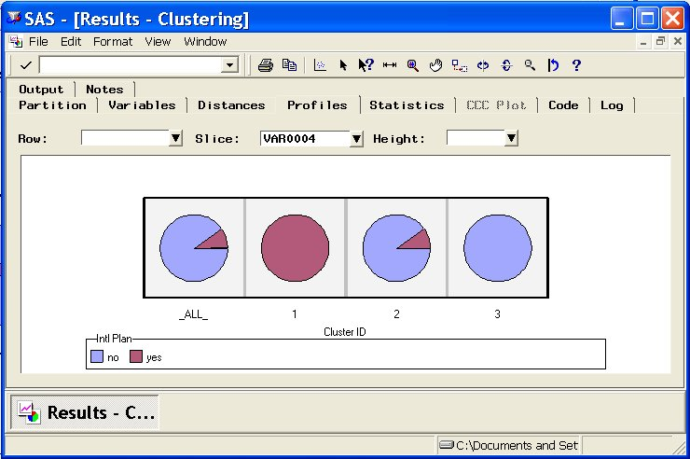
Application of k-Means Clustering Using SAS Enterprise Miner (cont’d)
  Three clusters uncovered vary significantly in size
  Cluster 1: 92 records, Cluster 2: 2,411 records, and Cluster 3: 830 records
  Cluster Profiling helps understand types of records comprising clusters
  Clustering results window from Enterprise Miner shows pie chart profile of International Plan across cluster membership
MD-MIS 637 - Fall 2020
1

Slide 30
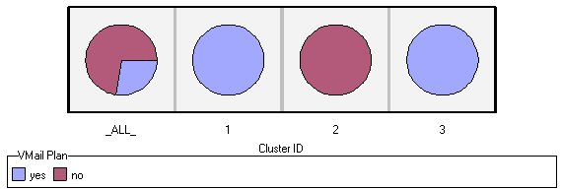
Application of k-Means Clustering Using SAS Enterprise Miner (cont’d)
  Cluster 1: All members adopted International Plan
  Cluster 2: Fraction adopted plan
  Cluster 3: None chose plan
  Below, results show profile of Voice Mail Plan across cluster membership
  Clusters 1 and 3: All members adopted Voice Mail Plan
  Cluster 2: None chose plan
MD-MIS 637 - Fall 2020
1

Slide 31
Application of k-Means Clustering Using SAS Enterprise Miner (cont’d)
  k-Means discriminates records according to Voice Mail Plan field value
  Divides data set perfectly among adopters and non-adopters
  Algorithm relies heavily on categorical attributes
  Mean values for numerical variables shows little variation across clusters
  Cluster Summary
  Cluster 1: Sophisticated Users
  Smallest group of customers
  Adopted International and Voice Mail Plans
MD-MIS 637 - Fall 2020
1

Slide 32
Application of k-Means Clustering Using SAS Enterprise Miner (cont’d)
  Cluster 2: The Average Majority
  Largest segment of customer base
  Some have adopted Voice Mail Plan
  None have adopted International Plan
  Cluster 3: Voice Mail Users
  Medium-sized group
  All have chosen Voice Mail Plan
  None have adopted International Plan
MD-MIS 637 - Fall 2020
1

Slide 33
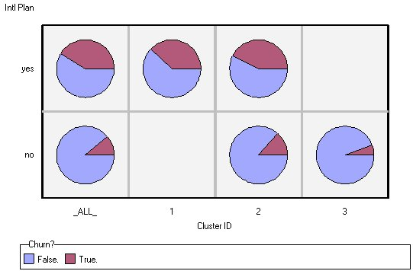
Using Cluster Membership to Predict Churn
  Suppose clusters are used to predict “churn” for classification
  Proportion for those churning analyzed for each cluster
  Diagram shows that proportion of churners higher for those adopting International Plan
  Company should investigate why those adopting plan leaving company at higher rate
MD-MIS 637 - Fall 2020
1

Slide 34
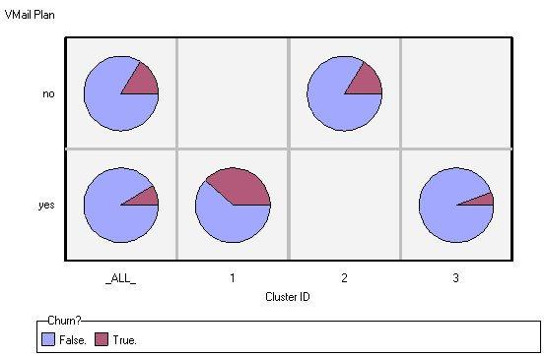
Using Cluster Membership to Predict Churn (cont’d)
  Recall proportion of churners lower, for those participating in Voice Mail Plan
  Figure confirms lower churn rate for customers in Cluster 3 (all adopters of Voice Mail Plan)
MD-MIS 637 - Fall 2020
1

